Slide 1
WAVES

Slide 2
INTRODUCTION
Physically, everything is a wave. That is why waves are very important.

Slide 3
A wave is an oscillation accompanied by a transfer of energy that travels through a medium.

Slide 4
For waves there must be source of oscillations and the medium.

Slide 5
Wave characteristics
T : Period = time it takes for the weave cycle
to complete.
f : frequency = how often the particles of
the medium vibrate when a wave passes
through the medium.
ω: angular frequency.
λ : wavelength = the distance over which
the wave's shape repeats.
v : wave front velocity = the velocity at which the first
rise of a pulse above zero moves forward.
x : distance.
y : displacement.

Slide 6
Wave expression

Slide 7
Problem 2:
2. When a sound wave is displayed at c.r.o. (Cathode-Ray Oscilloscope) screen, two complete waves occupy five scale divisions. The calibrated time-base is set on 0.005 s per division. Determine the frequency of the waves.

Slide 8
Problem 3:
3. Using the axes of displacement and distance, sketch two waves A and B such that A has twice the wavelength and half the amplitude of B.

Slide 9
Longitudinal and transverse waves
There are 2 types of waves longitudinal and transverse.
In longitudinal waves, the particles of the medium vibrate parallel to the direction of the wave velocity.
In transverse waves, the particles of the medium vibrate perpendicular to the direction of the wave velocity.
Sound wave is a longitudinal wave.
Electromagnetic wave is a transverse wave.

Slide 10
WAVES APPLICATIONS
As I speak, my sound waves reach your ears. These are longitudinal waves.
You see the waves in the water. These are transversal waves.
Mathematically, mechanical and electromagnetic waves are the same.

Slide 11
Phase and phase difference
Phase is the position of a point in time
(an instant) on a waveform cycle.
Phase difference is the difference, expressed in degrees or time, between two waves having the same frequency and referenced to the same point in time.

Slide 12
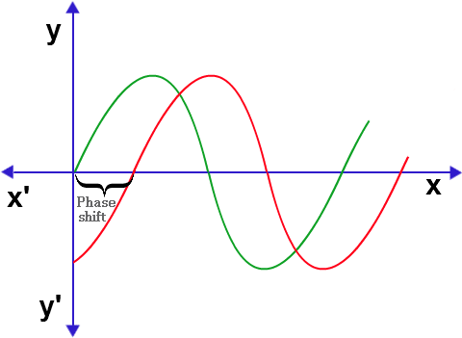

Slide 13
Wave energy:
Only energy is transmitted by the wave.
is volume
ρ
is density

Slide 14
Intensity
Intensity Amplitude²

Slide 15
Problem 4
4. A 100 W lamp emits electromagnetic radiation in all directions. Assuming a lamp to be a point source, calculate the intensity of the radiation:
a. at distance of 1.0 m from the lamp
b. at distance of 2.0 m from the lamp.

Slide 16
Problem 5
5. Waves from a source have an amplitude of 5.0 cm and an intensity of 400 Wm⁻².
a. The amplitude of the waves is increased to 10.0 cm. What is their intensity now?
b. The intensity of the waves is decreased to 100 Wm⁻². What is their amplitude?

Slide 17
Wave equation:
v = fλ

Slide 18
Doppler Effect

Slide 19
Problem 11
11. Red light of wavelength 700 nm in a vacuum travels into glass, where its speed decreases to 2.0×10⁸ms⁻¹. Determine:
a. the frequency of the light in vacuum
b. its frequency and wavelength in glass.

Slide 20
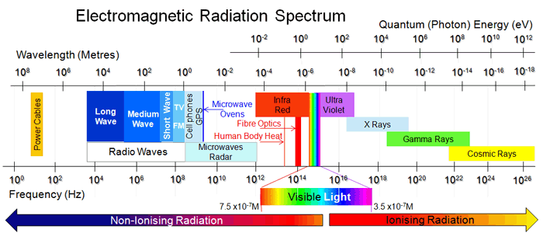

Slide 21
Problem 21
21. A transverse wave is transporting energy from east to west. The particles of the medium will move_____.
a. east to west only
b. both eastward and westward
c. north to south only
d. both northward and southward

Slide 22
Problem 22
22. A wave is transporting energy from left to right. The particles of the medium are moving back and forth in a leftward and rightward direction. This type of wave is known as a ____.
a. mechanical
b. electromagnetic
c. transverse
d. longitudinal

Slide 23
Problem 23
23. Describe how the fans in a stadium must move in order to produce a longitudinal stadium wave.

Slide 24
Problem 24
24. A sound wave is a mechanical wave, not an electromagnetic wave. This means that
a. particles of the medium move perpendicular to the
direction of energy transport.
b. a sound wave transports its energy through a
vacuum.
c. particles of the medium regularly and repeatedly
oscillate about their rest position.
d. a medium is required in order for sound waves to
transport energy.

Slide 25
Problem 25
25. A science fiction film depicts inhabitants of one spaceship (in outer space) hearing the sound of a nearby spaceship as it zooms past at high speeds. Critique the physics of this film.

Slide 26
Problem 26
26. If you strike a horizontal rod vertically from above, what can be said about the waves created in the rod?
a. The particles vibrate horizontally along the
direction of the rod.
b. The particles vibrate vertically, perpendicular to the
direction of the rod.
c. The particles vibrate in circles, perpendicular to the
direction of the rod.
d. The particles travel along the rod from the point of
impact to its end.

Slide 27
Problem 27
27. Which of the following is not a
characteristic of mechanical waves?
a. They consist of disturbances or oscillations of a
medium.
b. They transport energy.
c. They travel in a direction that is at right angles
to the direction of the particles of the medium.
d. They are created by a vibrating source.

Slide 28
Problem 28
28. The sonar device on a fishing boat uses underwater sound to locate fish. Would you expect sonar to be a longitudinal or a transverse wave?

