Slide 1
Superposition of waves

Slide 2
Superposition principle
the superposition principle,^{[1]} also known as superposition property, states that, for all linear systems, the net response at a given place and time caused by two or more stimuli is the sum of the responses that would have been caused by each stimulus individually. So that if input A produces response X and input B produces response Y then input (A + B) produces response (X + Y).

Slide 3
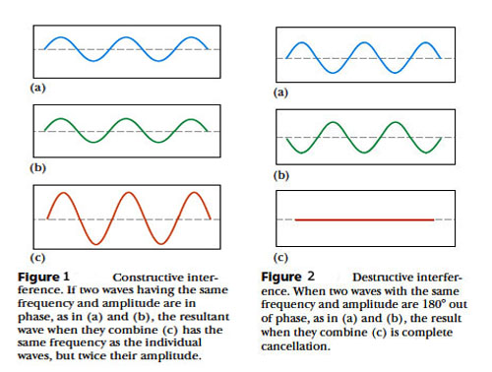

Slide 4
Diffraction
Diffraction refers to various phenomena that occur when a wave encounters an obstacle or a slit. It is defined as the bending of light around the corners of an obstacle or aperture into the region of geometrical shadow of the obstacle. In classical physics, the diffraction phenomenon is described as the interference of waves according to the Huygens–Fresnel principle. These characteristic behaviors are exhibited when a wave encounters an obstacle or a slit that is comparable in size to its wavelength. Similar effects occur when a light wave travels through a medium with a varying refractive index, or when a sound wave travels through a medium with varying acoustic impedance. Diffraction occurs with all waves, including sound waves, water waves, and electromagnetic waves such as visible light, X-rays and radio waves.

Slide 5
Diffraction (continued)
Since physical objects have wave-like properties (at the atomic level), diffraction also occurs with matter and can be studied according to the principles of quantum mechanics. Italian scientist Francesco Maria Grimaldi coined the word "diffraction" and was the first to record accurate observations of the phenomenon in 1660.
While diffraction occurs whenever propagating waves encounter such changes, its effects are generally most pronounced for waves whose wavelength is roughly comparable to the dimensions of the diffracting object or slit. If the obstructing object provides multiple, closely spaced openings, a complex pattern of varying intensity can result. This is due to the addition, or interference, of different parts of a wave that travel to the observer by different paths, where different path lengths result in different phases (see diffraction grating and wave superposition). The formalism of diffraction can also describe the way in which waves of finite extent propagate in free space. For example, the expanding profile of a laser beam, the beam shape of a radar antenna and the field of view of an ultrasonic transducer can all be analyzed using diffraction equations.

Slide 7
Interference
In physics, interference is a phenomenon in which two waves superpose to form a resultant wave of greater, lower, or the same amplitude. Interference usually refers to the interaction of waves that are correlated or coherent with each other, either because they come from the same source or because they have the same or nearly the same frequency. Interference effects can be observed with all types of waves, for example, light, radio, acoustic, surface water waves or matter waves.

Slide 8
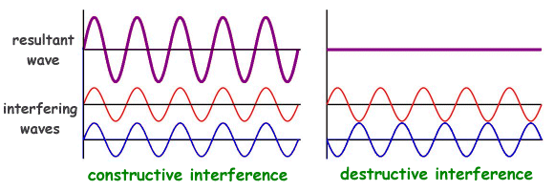

Slide 9
Double-slit experiment
The modern double-slit experiment is a demonstration that light and matter can display characteristics of both classically defined waves and particles; moreover, it displays the fundamentally probabilistic nature of quantum mechanical phenomena. A simpler form of the double-slit experiment was performed originally by Thomas Young in 1801 (well before quantum mechanics). He believed it demonstrated that the wave theory of light was correct, and his experiment is sometimes referred to as Young's experiment^{[1]} or Young's slits. The experiment belongs to a general class of "double path" experiments, in which a wave is split into two separate waves that later combine into a single wave. Changes in the path lengths of both waves result in a phase shift, creating an interference pattern. Another version is the Mach–Zehnder interferometer, which splits the beam with a mirror.

Slide 10
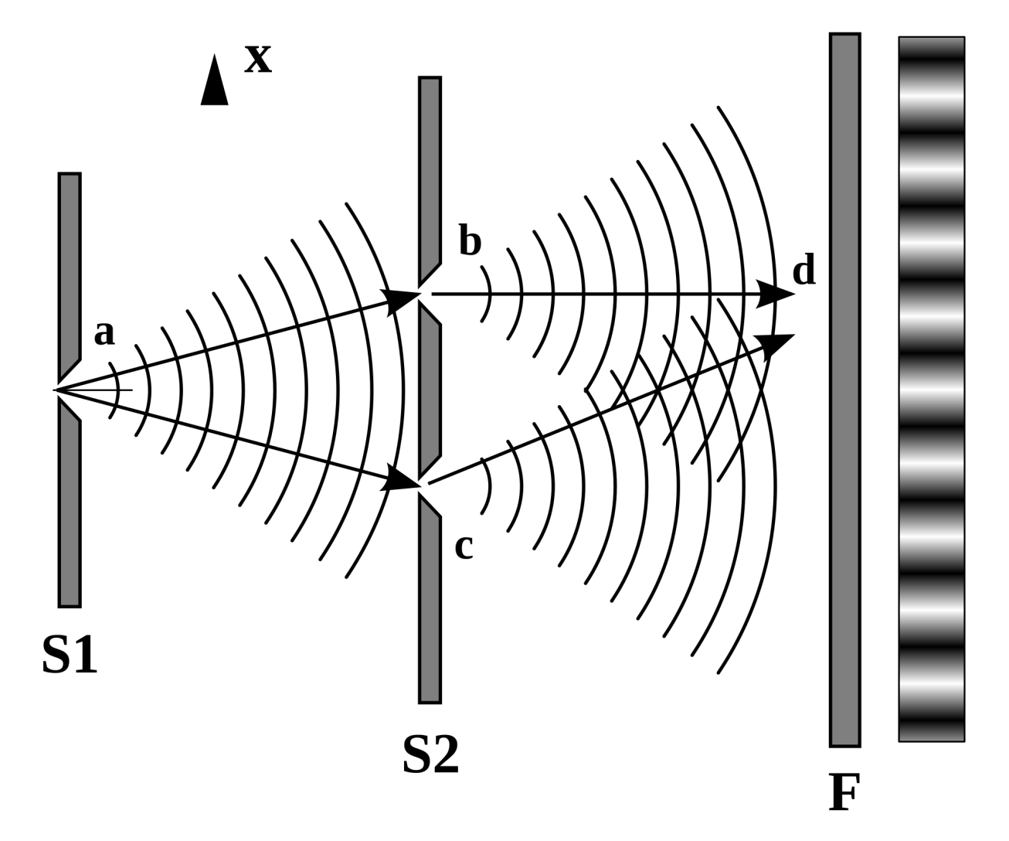

Slide 11
Diffraction grating
In optics, a diffraction grating is an optical component with a periodic structure, which splits and diffracts light into several beams travelling in different directions. The emerging coloration is a form of structural coloration.^{[1][2]} The directions of these beams depend on the spacing of the grating and the wavelength of the light so that the grating acts as the dispersive element. Because of this, gratings are commonly used in monochromators and spectrometers.
For practical applications, gratings generally have ridges or rulings on their surface rather than dark lines. Such gratings can be either transmissive or reflective. Gratings which modulate the phase rather than the amplitude of the incident light are also produced, frequently using holography.^{[3]}
The principles of diffraction gratings were discovered by James Gregory, about a year after Newton's prism experiments, initially with items such as bird feathers.^{[4]} The first man-made diffraction grating was made around 1785 by Philadelphia inventor David Rittenhouse, who strung hairs between two finely threaded screws.^{[5]} This was similar to notable German physicist Joseph von Fraunhofer's wire diffraction grating in 1821.^{[6]}
Diffraction can create "rainbow" colors when illuminated by a wide spectrum (e.g., continuous) light source. The sparkling effects from the closely spaced narrow tracks on optical storage disks such as CDs or DVDs are an example, while the similar rainbow effects caused by thin layers of oil (or gasoline, etc.) on water are not caused by a grating, but rather by interference effects in reflections from the closely spaced transmissive layers (see Examples, below). A grating has parallel lines, while a CD has a spiral of finely-spaced data tracks. Diffraction colors also appear when one looks at a bright point source through a translucent fine-pitch umbrella-fabric covering. Decorative patterned plastic films based on reflective grating patches are very inexpensive, and are commonplace.

