Slide 1
WAVES

Slide 2
A wave is an oscillation accompanied by a transfer of energy that travels through a medium.

Slide 3
For waves there must be source of oscillations and the medium.

Slide 4
Wave characteristics
T : Period = time it takes for the weave cycle
to complete.
f : frequency = how often the particles of
the medium vibrate when a wave passes
through the medium.
ω: angular frequency
λ : wavelength = the distance over which
the wave's shape repeats.
v : wave front velocity = the velocity at which the first
rise of a pulse above zero moves forward.
x: distance
y: displacement

Slide 5
Problem 2:
When a sound wave is displayed at c.r.o. (Cathode-Ray Oscilloscope) screen, two complete waves occupy five scale divisions. The calibrated time-base is set on 0.005 s per division. Determine the frequency of the waves.

Slide 6
Problem 3:
Using the axes of displacement and distance, sketch two waves A and B such that A has twice the wavelength and half the amplitude of B.

Slide 7
Longitudinal and transverse waves
There are 2 types of waves longitudinal and transverse.
In longitudinal waves, the particles of the medium vibrate parallel to the direction of the wave velocity.
In transverse waves, the particles of the medium vibrate perpendicular to the direction of the wave velocity.
Sound wave is a longitudinal wave.
Electromagnetic wave is a transverse wave.

Slide 8
Phase and phase difference
Phase is the position of a point in time
(an instant) on a waveform cycle.
Phase difference is the difference, expressed in degrees or time, between two waves having the same frequency and referenced to the same point in time.

Slide 9
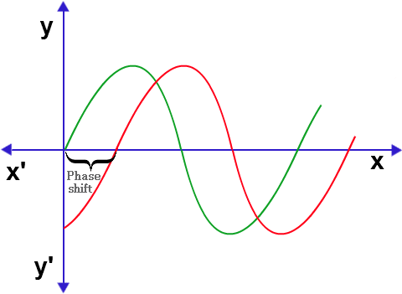

Slide 10
Wave energy:
Only energy is transmitted by the wave.

Slide 11
Intensity
Intensity Amplitude²

Slide 12
Problem 4:
A 100 W lamp emits electromagnetic radiation in all directions. Assuming a lamp to be a point source, calculate the intensity of the radiation:
a. at distance of 1.0 m from the lamp
b. at distance of 2.0 m from the lamp.

Slide 13
Problem 5:
Waves from a source have an amplitude of 5.0 cm and an intensity of 400 Wm⁻².
a. The amplitude of the waves is increased to 10.0 cm. What is their intensity now?
b. The intensity of the waves is decreased to 100 Wm⁻². What is their amplitude?

Slide 14
Wave equation:
v = fλ

Slide 15
Doppler Effect

Slide 16
Problem 11:
Red light of wavelength 700 nm in a vacuum travels into glass, where its speed decreases to 2.0×10⁸ms⁻¹. Determine:
a. the frequency of the light in vacuum
b. its frequency and wavelength in glass.

Slide 17
